Slide 1
VISUAL C#.NET session 7
Instructor: Edwin oduor

Slide 2

Quote of the day

Slide 3
Lesson objectives
Error handling in C#
Types of Errors
Design Time Error
Run Time Error
Logic Errors

Slide 4
Lesson pre-requisites
In order to take full advantage of this section you need to have the following;
Computer with Visual Studio Installed.
Stable Network Connection.

Slide 5
Training methods and extra readings
TRAINING METHODS FOR THIS LESSON
EXTRA READINGS
Lecturing Method – This is the main method of training to be adopted in this lesson with illustrations and practical coding examples.
Discussion Method - This method will be adopted periodically whereby learning will be derived principally from the students brainstorming together, rather than from the trainer. Three main types of discussions will be used:
Directed discussion
Developmental discussion
Problem-Solving discussion
Home and Learn C#

Slide 6
ERRORS

Slide 7
WHAT ARE ERRORS

Slide 8
An error is an illegal operation performed by the user, causing your application or system to crush.
Another definition is that they are problems that occurs when using the system making the system to behave abnormally.
They are problems that occur while writing code.
Another name for errors is a bug the processing of removing the error is known as debugging.

Slide 9
When coding or when writing code as developers we will always come across errors this is one thing that we can’t avoid as developers. In this topic we will see the different types of errors that developers encounter in their programming life, then we will be able to see how to go about it to prevent the errors from happening.

Slide 10
Types of errors

Slide 11
1. Design time error
This are types of error that are encountered before the program runs. With design time error the program won’t run at all, when one tries to run the program a pop-up message will show telling the user that there were build up errors.
To identify these errors are easy because the code with the error is going to be underlined. When underlined in blue simply means one can edit and continue, red syntax error something is missing i.e. closing the code with semi-colon, green when C# spots something that might potentially bring some problem in future, for instance declaring a variable initializing it with a value and not using the variable then its going to be highlighted in green.

Slide 12
2. Run time error
This is a type of error that occurs when the system is running, this type of error won’t prevent your system from running, but the moment the system tries to do a task that it can’t do then the system will crush, for instance when one tries to divide a number by zero and there are no proper mechanisms put in place to prevent this error then the system will crush, another example is when the system is trying to access a database whose location has been changed or maybe the database is deleted then a run time error will occur.

Slide 13
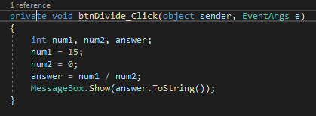
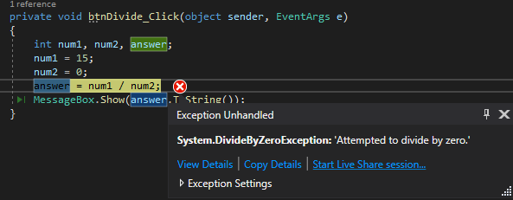
2. Run time error cont..
Once the button is clicked on then the above error (right) will be displayed, this is an example of a run time error.
How do we go ahead and prevent this error from happening? Through the use of Try Catch block.

Slide 14
2. Run time error. Try catch
try
{
//code to be checked goes here
} catch (System. Exception ex)
{
// incase there is an error message will be printed
}
finally
{
// this code has to be executed- clean up code
}

Slide 15
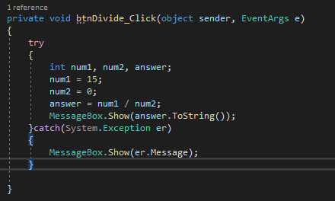
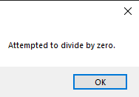
Using Try catch block
In the above code we have now used the try catch block, when the button is clicked on then an appropriate message is given hence the system is not crushing.

Slide 16
3. Logic errors
A logic error is a type of error that gives an output that you were not expecting when running the program. With logic errors the program wont crush, the system will work on perfectly but the moment you do something or try to execute its going to execute but give out some incorrect answer.

